Slide 1
CS626 - Speech, Natural Language Processing, and the Web
Assignment-1a POS Tagging Using HMM
Group Id- 42
Jayesh Jadhav, 22B1056, Computer Science
Kaushal Malpure, 22B1276, Electrical Engineering
Sachi Deshmukh, 22B1213, Electrical Engineering
Prasanna Nage, 22B0953, Computer Science
Date: 07/09/2024

Slide 2
Problem Statement
Objective: Given a sequence of words, produce the POS tag sequence using HMM-Viterbi
Input: The quick brown fox jumps over the lazy dog
Output:The_{DET} quick_{ADJ} brown_{ADJ} fox_{NOUN} jumps_{VERB} over_{ADP} the_{DET} lazy_{ADJ}dog_{NOUN}
Dataset: Brown corpus
Use Universal Tag Set (12 in number)
– <list of tags>
k-fold cross validation (k=5)

Slide 3
Data Processing Info (Pre-processing)
<for example, lower casing, tokenization, etc.>

Slide 4
Overall performance
Precision: 0.9422054517306861
Recall: 0.913226212734768
F-score (3 values)
F₁-score: 0.9243217411158184
F_{0.5}-score: 0.9338380507205188
F₂-score: 0.9171357802147465

Slide 5
Per POS performance
ADJ: 0.921, 0.911, 0.916
ADP: 0.950, 0.968, 0.959
ADV: 0.909, 0.896, 0.902
CONJ: 0.993, 0.995, 0.994
DET: 0.968, 0.987, 0.977
NOUN: 0.962, 0.952, 0.957
NUM: 0.971, 0.913, 0.941
PRON: 0.954, 0.985, 0.969
PRT: 0.908, 0.907, 0.907
VERB: 0.972, 0.951, 0.962
X: 0.804, 0.493, 0.609
. : 0.996, 1,000, 0.998

Slide 6
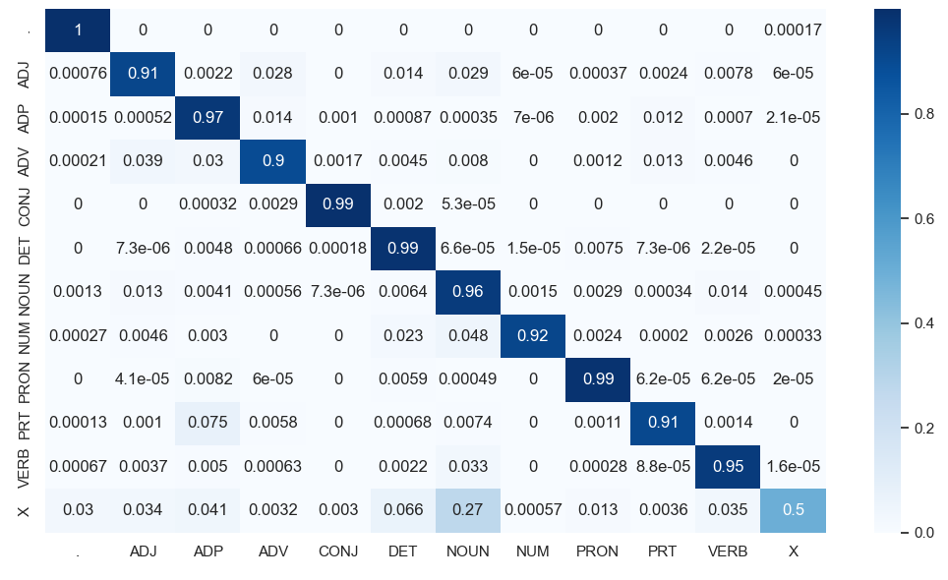
Confusion Matrix (12 X 12) (can give heat map)

Slide 7
Interpretation of confusion (error analysis)
<list maximal confusions; which tag is confused with which tag most>
<try giving reasons>

Slide 8
Inferencing/Decoding Info
In Viterbi algorithm we are first creating two T by K matrices (T= no. of words in sentence, K=no. of tags). In each position (i,j) of the matrix, we will store the maximum log probability possible for the i th word to have tag number j. Then from each row, we select the tag having the maximum probability value in that row. For calculating the probability value, we are using the emission and transition matrices which are given as arguments to the Viterbi function. The final tag sequence having maximum probability is then returned by the Viterbi function.

Slide 9
Benchmarking against ChatGPT
<Describe which tags does ChatGPT gets most confused>
<Compare the performance of HMM for each POS against ChatGPT> (It can shown through plot as well but it is optional)
<What cases does HMM perform better than ChatGPT and vice versa>
<try giving reasons>

Slide 10
Challenges faced
<Describe any challenges faced in understanding concept or during implementation>

Slide 11
Learning
In this assignment, we applied our knowledge of Hidden Markov Models and Viterbi algorithm to design a program to do POS tagging given any sentence as input. This learning can be scaled to NLP tasks like the named entity recognition where words can be classified into entities like LOCATION, PERSON, ORGANISATION, etc. We can also use it for word sense disambiguation where the hidden states will be the various possible meanings of the word.

Slide 12
References
For Brown corpus http://www.nltk.org/nltk_data
For GUI
https://www.gradio.app/
https://streamlit.io/
Any JS or python framework
Other references e.g. Lectures notes, videos, blogs etc

Slide 13
Marking Scheme (50)
Demo working- 10/10 (if not working - 0)
Implemented Viterbi and Clarity on Viterbi- 5/5
Transition and Lexical tables clearly described- 5/5
Confusion matrix drawn and error analysed- 5/5
Overall F₁-score
a. > 90 - 10/10
b. >80 & <=90 - 8/10
c. >70 & <=80 - 7/10
d. so on.
Unknown word handling- done (5/5; else 0)
Benchmarking against ChatGPT (10 else 0)
Note: Must have GUI, otherwise no mark will be given for demo.

